Slide 1
Books and Reference Material
ejrnvn7
Google class room Code:bi6wyzw
TextBook:Ramez Elmasri & Shamkant B. Navathe, Database Systems, Models, Languages, Design and Application Programming, 7th Edition, 2016.
Reference Books:Thomas Connolly, Carolyn Begg, Database Systems: A practical approach to design, implementation and Management, 6th Edition, 2015.
C.J. Date, An Introduction to Database Systems, 8th Edition, 2004

Slide 2
Week Wise Lab Course Plan
Lab Course Topics | No of Weeks | Contact Hours
Lab-01: Introduction &amp; History of Database Systems, Introduction of SQL | 01 | 03
Lab-02: Basic SQL Schema and Statements, Arithmetic operators, Column Alias, Concatenation Operator, Where Clause, Comparison Operators &amp; Conditions, Logical Conditions (AND, OR, NOT), Functions (count, max, min, Dates),Operators(Like, Rownum, In, Between), Order by clause | 01 | 03
Lab-03: DDL(create, alter, drop, truncate, rename), Defining constraints on table, types of constraints, deferred constraint checking(chicken egg problem) and DML (Create, insert, update, delete) | 01 | 03
Lab-04: Sub queries ( Single Row, Multiple Rows and correlated),Groups of Data(Group by ,Having) | 01 | 03
Lab-05: Joins, Types of Joins (Equality Joins, Non Equality Joins, Outer Joins and Self Joins), Set Operators (union, union all, intersection, minus). | 02 | 06
Lab-06:Connectivity of PHP with MYSQL Server, Java with MYSQL Server & C# with SQL Server.
Lab-07: Relational Modeling | 01 | 03
MID EXAMS

Slide 3
Lab Course Topics: Continued | No of Weeks | Contact Hours
Lab-08: PL/SQL: Block Structure, Variables and Types, Conditional Logic, Cursors, Views, Procedures and Functions. | 01 | 03
Lab-09: Triggers | 01 | 03
Lab-10:Transactions | 01 | 03
Lab-11: Transaction(Multi-user Experiment) | 01 | 03
Lab-12: NO-SQL(Mongo DB Installation & Basics, Projection & Functions) | 01 | 03
Revision

Slide 4
Marks Distribution
Mid exam: 25
Lab work: 20
Project: 05(10 marks in theory as well)
Final: 50
Lab Submission Deadline: One Week (Before Next Lab)
Late Submission of labs will result in 50% deduction of marks.
No leniency in attendance.

Slide 5
Data VS Information
Khi | Sales | Isb
10 | Lhr | 20
Marketing | 30 | finance

Slide 6
Information
DEPT_NO | DEPT_NAME | DEPT_LOCATION
10 | Sales | Khi
20 | Marketing | Lhr
30 | Production | Isb

Slide 7
Why Databases?
Businesses cannot run without knowing their data: customers, products, prices, employees, wages, etc.?
Properly maintained data is important in decision making and hence in the success of a business.
The amount of data utilized in a business can grow fast. Examples:
Phone companies keep data on trillions of phone calls, adding 70,000 calls per second.
Google is estimated to perform 91 million searches per day across a data that is several terabytes in size.
How do these businesses maintain this data? and do searches
on this data to find desired information?
Answer: By using Databases

Slide 8
What Is Database??
A database is an organized collection of structured information, or data, typically stored electronically in a computer system.
OR
A database represents some aspect of the real world, sometimes called the miniworld or the universe of discourse (UoD).
Data within the most common types of databases in operation today is typically modeled in rows and columns in a series of tables to make processing and data querying efficient.
The data can then be easily accessed, managed, modified, updated, controlled, and organized. Most databases use structured query language (SQL) for writing and querying data.

Slide 9
What Is DBMS?
A database typically requires a comprehensive database software program known as a database management system (DBMS). A DBMS serves as an interface between the database and its end users or programs, allowing users to retrieve, update, and manage how the information is organized and optimized.
Some examples of popular database software or DBMSs include MySQL, Microsoft Access, Microsoft SQL Server, FileMaker Pro, Oracle Database, and dBASE.

Slide 10
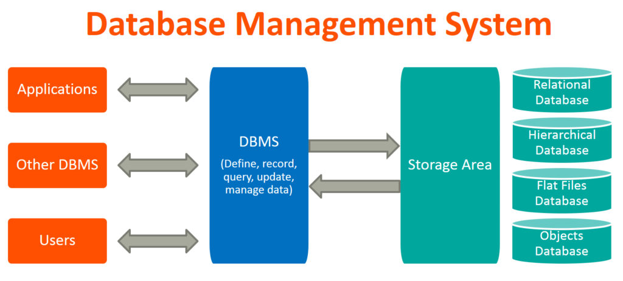

Slide 11
Difference Between A Database And A Spreadsheet?
Spreadsheets were originally designed for one user, and their characteristics reflect that. They’re great for a single user or small number of users who don’t need to do a lot of incredibly complicated data manipulation.
Databases, on the other hand, are designed to hold much larger collections of organized information—massive amounts, sometimes. Databases allow multiple users at the same time to quickly and securely access and query the data using highly complex logic and language.

Slide 12
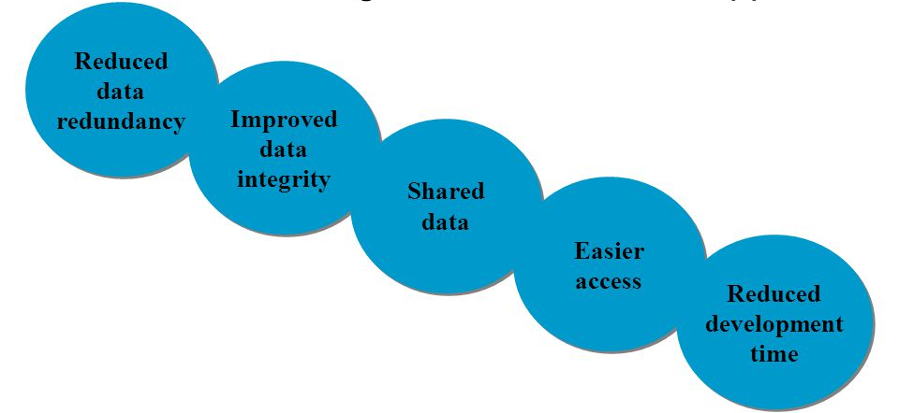
Characteristics of DB Approach

Slide 13
Types of DBMS
Relational(SQL databases)
Data Model is based on tables
Non-Relational(NoSQL databases)
Data Model is based on XML,JSON or Plain Text i.e. no tabular form of db.
Network
Data Model based on graph with nodes as records and relationship between records as edges.
Hierarchical
Data Model based on tree data structure
Object Oriented
Data Model based on Object Oriented paradigm
Distributed
Composed of several independent DBMS running at the nodes of a Communication Network.

Slide 14
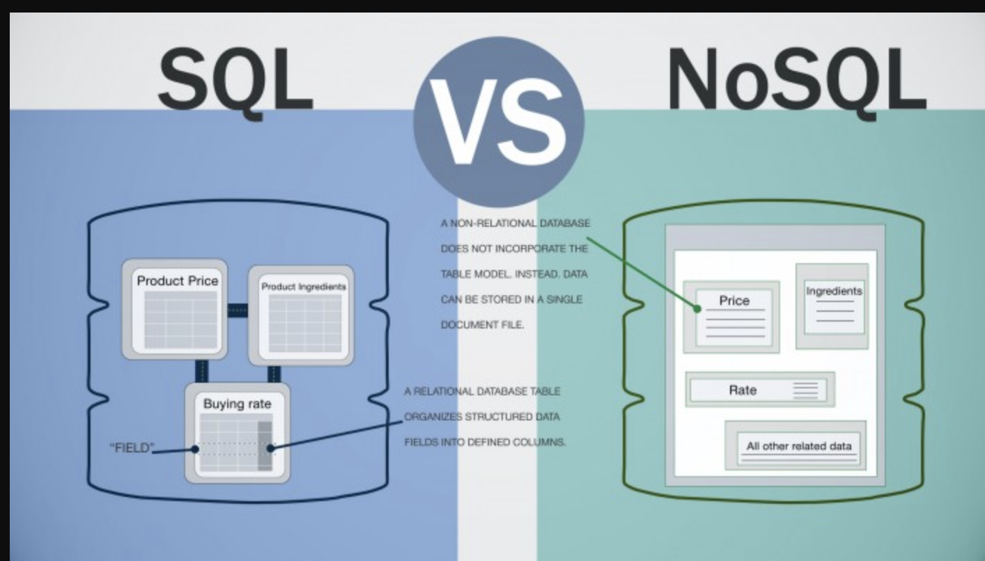
Difference b/w SQL & NOSQL

Slide 15
RDBMS
RDBMS stands for Relational Database Management System.
RDBMS is the basis for SQL, and for all modern database systems such as MS SQL Server, IBM DB2, Oracle, MySQL, and Microsoft Access.
The data in RDBMS is stored in database objects called tables. A table is a collection of related data entries and it consists of columns and rows.

Slide 16
RDBMS Examples:
Nadra is having its multiple database across the country.
NUCES-Fast having multiple campuses across the country.

Slide 17
What is SQL?
SQL stands for Structured Query Language.
SQL lets you access and manipulate databases.
SQL became a standard of the American National Standards Institute (ANSI) in 1986, and of the International Organization for Standardization (ISO) in 1987.
What Can SQL do?
SQL can execute queries against a database
SQL can retrieve data from a database
SQL can insert records in a database
SQL can update records in a database
SQL can delete records from a database
SQL can create new databases
SQL can create new tables in a database

Slide 18
Advantages
Structured Data
Consistent format of Data.
Non-predetermined access to data.
No data Redundancy.
Concurrent Access Control Mechanism.
Integrity Constraints.
Security of data.
Recovery Mechanism.
Isolation facility.

Slide 19
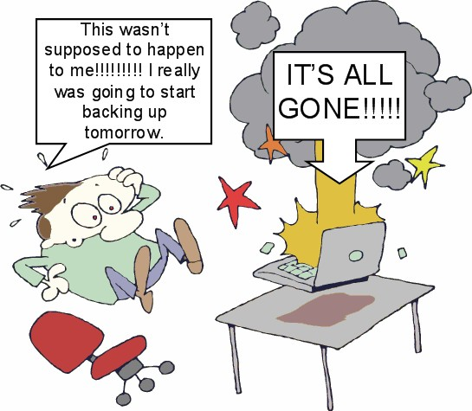
Disadvantages…
Higher Cost
We need specialized s/w, h/w and trained resources
Conversion Cost
Initial Conversion from Manual System or FPS requires a cost
More Difficult Recovery
Since DB recovery is technical hence more difficult
Overheads
providing security, concurrency control, recovery and integrity functions

Slide 20
When Not To Use Database?
If size of data is too low and application requirements need not be changed
If access to data by multiple users is not required
If users need specialized operations which are not supported by DBMS

Slide 21
Q & A

